Slide 1
CAFE UNBOUND
Production Observation Report
An Economic & Operational Analysis of Labour and Capital Constraints
in a Small Cloud-Style Cafe Kitchen
Submitted by: Arshalan Noor | Roll No. 26PGDM009 | Post Graduate Diploma in Management
Business Profile: Cloud-Style Cafe Kitchen (Founded 2022) | Core Product: Coffee
Notes:
Speaker Notes:
- Welcome the audience to the presentation of the Cafe Unbound Production Observation Report.
- Grounding: The site visit and research were conducted by Arshalan Noor (Roll No. 26PGDM009) [1].
- Cafe Unbound is a cloud-style kitchen founded in 2022 that specializes in quick-prep items like fries, burgers, sandwiches, and high-volume coffee [1].
- The objective of this presentation is to detail the microeconomic factors impacting the cafe's daily operations, specifically its labor and capital inputs, technology gaps, demand swings, and short-run diminishing returns.

Slide 2
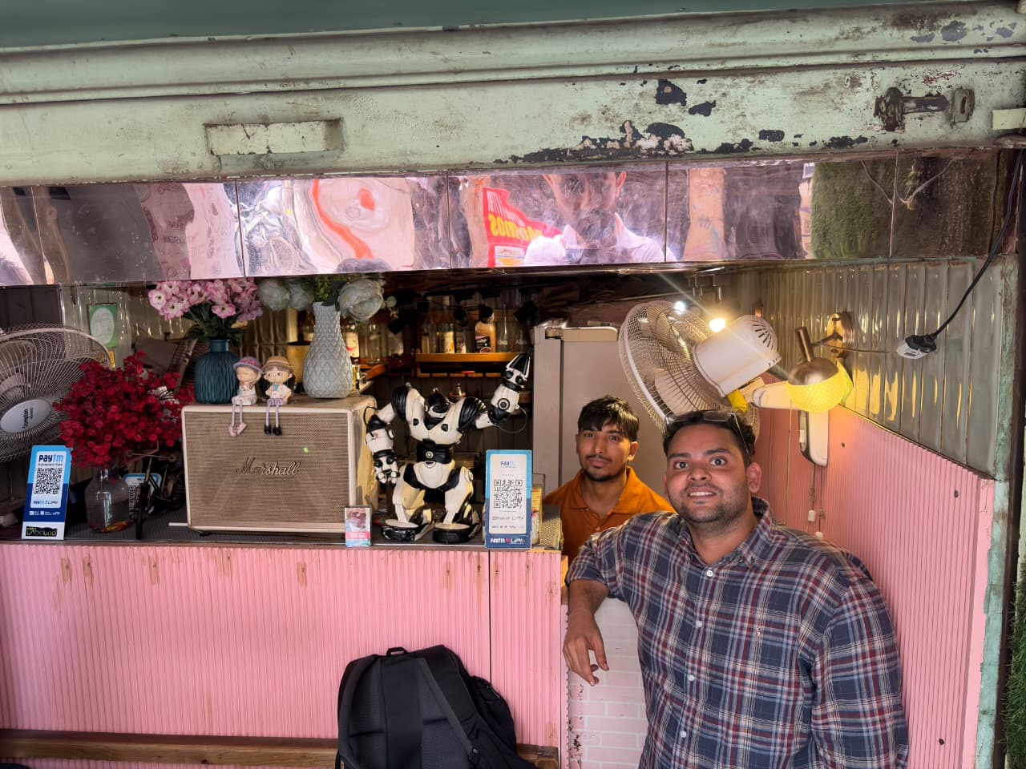
Delhi University student base drives high demand for best seller OG Coffee
• Establishment & Tenure: Founded in 2022, the cloud-style kitchen has successfully completed four years of continuous operation.
• Core Menu Category: Focuses on fast-prep products: Coffee varieties, French fries, sandwiches, and burgers.
• Highest-Volume Product: The 'OG Coffee' is the designated menu best-seller, capturing the highest volume of consumer orders.
• Daily Target Output: Regularly handles a baseline of 150+ cups of coffee over a standard 12-hour operational day.
• Market Competition: Operates in a highly concentrated Delhi University campus area with fierce competition from numerous surrounding cafes.
Notes:
Speaker Notes:
- Slide 2 establishes the core business parameters of Cafe Unbound [1].
- It's a cloud-style cafe kitchen that has been operating since 2022 near Delhi University colleges [1].
- Note the high-volume nature of their operations: serving 150+ cups of coffee daily on a regular day, with 'OG Coffee' as their top seller [1, 9].
- On the right, I have reserved a prominent placeholder box styled perfectly for the site visit photograph of Arshalan at the billing counter [20].
- When you deliver this editable PPT to the user, they can copy-paste that first photo directly into this box to preserve the report's empirical evidence [20].

Slide 3
Fixed 2-person staff and single-unit kitchen machinery cap daily throughput
🧑‍🍳 LABOUR LIMITATIONS
• Thin Permanent Base: Operations rely on exactly 2 permanent workers (Aalam and his colleague). There is zero temporary staff to handle volume spikes.
• Overextended Shifts: Staff handle extensive 12-hour shifts daily, splitting roles between order-taking, beverage prep, and hot food cooking.
• Experience Ceiling: While workers are on-the-job trained with 4 years of experience, their physical capability is capped during peak college hours.
☕ CAPITAL & SUPPLY CHAIN
• Single-Unit Kitchen: Fitted with exactly one coffee machine, one mixer-grinder, and one panini press. No backup machinery is available during rushes.
• Manual Sourcing: Owner physically procures basic packaging materials and fresh ingredients from Palika Bazar. No automated supply chain or bulk logistics.
• Fixed Capital Base: No new equipment has been purchased in 1 to 1.5 years, capping the physical kitchen preparation capacity.
Notes:
Speaker Notes:
- Slide 3 goes into detail about the physical production inputs of the business: Labor and Capital [2].
- On the labor side, the cafe depends entirely on 2 permanent staff working long 12-hour daily shifts [1, 2]. They have no back-ups.
- On the capital side, the equipment is modest and single-unit: 1 coffee machine, 1 panini press, and 1 blender [2].
- This means the cafe faces a dual physical capacity cap. Having only 2 pairs of hands and a single coffee machine creates an absolute ceiling during peak hours, which we will examine from an economic standpoint soon [10, 11].

Slide 4
Manual billing and zero online listing leave easy efficiency gains on the table
📊 MANUAL BILLING
Transaction Bottleneck
Order taking and billing are fully manual without any digital software. Writing receipts and manual arithmetic directly slow down service precisely when counter speed matters most.
🏍️ NO ONLINE LISTING
Capped Delivery Reach
The cafe has zero listing on food aggregators like Swiggy or Zomato. This leaves them completely isolated from the online market, missing a key channel to hedge walk-in volatility.
📦 NO SYSTEM SYSTEMS
Unmanaged Inventory
Inventory, stock tracking, and ingredient management are informal. Reordering is subjective, leading to emergency owner sourcing runs to Palika Bazar.
Notes:
Speaker Notes:
- Slide 4 looks at operational technology. The major takeaway is that technology is under-utilized [3, 12].
- First, billing: writing receipts by hand slows down order placement right at the counter, which aggregates wait times [12].
- Second, online platforms: there is zero presence on food delivery apps like Swiggy and Zomato [3]. Aalam notes that 'children want it fast' but being offline means there is no way to capture online student orders [5, 12].
- Third, stock management: there is no POS or inventory system to track ingredients or manage stock levels [3]. This means inventory is managed informally [3].

Slide 5
Academic calendar swings force student wait times up to 200+ visits
📈 DEMAND VOLATILITY
• Exam Rushes: Footfall surges to 150 - 200+ customers daily as nearby Delhi University college students pack the shop.
• Off-Peak Rainy Days: Footfall drops drastically to just 50 customers per day. The lack of online presence makes off-peak periods highly unhedged.
• High Cash Flow Risk: Because fixed operating hours and labor payroll remain constant, demand spikes are difficult to capture efficiently.
🎯 COMPETITOR LEAKAGE
• High Substitute Satiation: The surrounding campus area is saturated with local cafes vying for the same student segment.
• Visual Queue Barriers: When a crowd gathers, queues look long. Rushed students immediately walk away and visit competitors.
• Missed Revenue Potential: With only 2 workers and 1 coffee machine, the physical layout itself serves as a capacity barrier that leaks potential revenue.
Notes:
Speaker Notes:
- Slide 5 addresses demand swings and market competition [6, 9].
- Demand is tied directly to the university academic calendar, with huge swings between exam spikes (150-200 customers) and low days like rainy periods (50 customers) [5, 6, 9].
- High campus competition means students have zero tolerance for waiting. Aalam notes in the interview that jinko jaldi chahiye aur jinke paas time nahi rahega, wo door ke online pe or dusre cafes pe chale jayenge [6].
- The physical layout and thin labor base turn demand surges into bottlenecks, directly leaking revenue to competitors [10].

Slide 6
Cobb-Douglas analysis (Q = A * L^a * K^b) proves fixed L=2 and K=1 inputs limit peak scaling
📊 COBB-DOUGLAS ECONOMIC MODEL
Q = A • L^α • K^β
• Labour Input (L = 2): Labour is fixed in the short run at exactly 2 permanent workers (Aalam and colleague). No secondary shifts.
• Capital Input (K = 1): Capital is fixed with single units of essential kitchen equipment (1 coffee machine, 1 panini press).
• Fixed Scaling Limit: Because both L and K are fixed, Cafe Unbound operates under a strict capacity cap during university rush periods.
⚠️ DIMINISHING MARGINAL RETURNS
• Demand Delta Strain: As customer volume scales from 50 to 150+, output (orders served) does not increase proportionally due to structural backlogs.
• Counter Overcrowding: Simply cramming more workers behind the same counter with a single coffee machine would not increase output; it would cause physical layout friction.
• Experienced but Saturated: Workers are highly experienced (4 years tenure), showing that performance bottlenecks are purely structural, not motivational.
Notes:
Speaker Notes:
- Slide 6 is the analytical core of the report: short-run diminishing marginal returns [13].
- Using the Cobb-Douglas production function, we model output Q as a function of Technology, Labor (L), and Capital (K) [13].
- In the short run, L is fixed at 2 and K is fixed at 1 coffee machine [13].
- As a result, when demand spikes, the cafe experiences diminishing marginal returns. Adding more customer demand pressure without scaling labor or capital results in queues, slower service, and customer walk-aways rather than higher output [14].
- Note that this is a structural bottleneck, not a labor productivity issue. Workers have 4 years of experience and are highly efficient [2, 14].

Slide 7
Three key tactical shifts to unlock revenue and scale capacity
1. FLEXIBLE PEAK LABOUR STAFFING
Action: Hire temporary or part-time student staff specifically during university exam weeks to handle the cashier counter.
Expected Impact: Relieves the severe labour bottleneck without locking the cafe into high permanent fixed payroll costs during seasonal low periods.
2. DIGITIZE COUNTER OPERATIONS (POS BILLING SOFTWARE)
Action: Adopt a basic, tablet-based POS billing software to digitize calculations and order processing.
Expected Impact: Slashes transaction times at the counter, enabling Aalam to focus entirely on food/beverage preparation instead of manual arithmetic.
3. OMNICHANNEL REVENUE GENERATION (DELIVERY LISTING)
Action: Formally list Cafe Unbound on major delivery platforms like Swiggy and Zomato.
Expected Impact: Directly offsets seasonal physical demand drops (e.g. 50 customers on rainy days), broadening the market beyond active walk-ins.
Notes:
Speaker Notes:
- Finally, Slide 7 presents actionable strategic recommendations to resolve the operational bottlenecks of Cafe Unbound [16, 17].
- Recommendation 1: Hire flexible, part-time student workers specifically during exam periods. This increases headcount to 3 or 4 temporarily when demand spikes, resolving the labor bottleneck [16].
- Recommendation 2: Introduce simple digital billing (e.g., POS tablet). This frees up staff time from manual calculation to food prep, directly easing operational throughput [17].
- Recommendation 3: List the cafe on Swiggy or Zomato to establish a digital delivery channel. This creates a cushion to offset physical traffic drops on rainy days [17].

